Slide 1
Customer Retention Case-study.
E-retail factors for customer activation and retention in the Indian online Retail Sector.
Project Report
Submitted by : Nilotpal Mukherjee

Slide 2
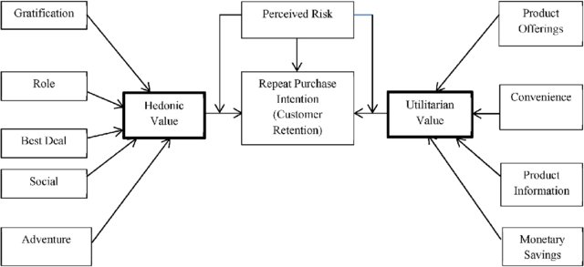
THE PROBLEM AT HAND.
As customer satisfaction drives the growth of the online retailers influencing in retaining and stimulating purchases and repurchases it is of utmost importance to explore what are the factors that drives the customers.
The companies must also provide hedonic values and utilitarian values to its customers like bet deals, a sense of adventure, social value of the product, etc. If these criteria are met with then it will result in better customer retention and at the same increase the customer base.

Slide 3
THE DATASET AT HAND.
The dataset contained 269 – rows and 71 columns of which the datatype was object.
The dataset was without missing value or nan- values.
The dataset (of 71 columns) 70 columns are having an object data-type and 1 column is having int64.
Overall the dataset was categorical in nature.
It not only dealt with the preference of the people or gender or age group but also various geography.

Slide 4
APPROACHING THE DATASET.
The dataset was first checked for the number of columns it had.
Then the data type contained in the dataset was checked.
Then it was checked for missing values.
Then the EDA process mainly consisted of univariate , bivariate and multivariate analysis.
As the dataset had overlapping values for various observations it had to split into different columns to get a better count.
Later due to splitting the dataset had to be adjusted for cleaning as the splitting left missing values the missing value were replaced with 0(zero).
Later for those columns that were split ,each column had to be expanded to 4 columns each. So for the 25 columns that were split which were having overlapping values 25 X 4= 100 columns were added.

Slide 5
Tools used.
import pandas as pd
import numpy as np
import seaborn as sns
import matplotlib.pyplot as plt
%matplotlib inline
import warnings
warnings.filterwarnings('ignore')

Slide 6
Exploratory Data Analysis.
Basically three different types of analysis was used to best describe the dataset at hand namely : (mainly shown through visualizations using matplotlib and seaborn libraries.)
Univariate analysis
Bi-variate analysis
Multivariate analysis
The analysis helped discover the male to female ratio.
The different places involved with their pin code.
The different online retailers involved.
On observing the dataset it could be seen that the dataset had customer opinions on matters affecting trust , reliability , security and recommendation to name a few.
It could also be observed that the dataset had a lot of overlapping on the data related to the opinion of the people this overlapping caused a sense of ambiguity on understanding the particular standings of each online retailers.
Splitting the dataset on cases raising ambiguity helped provide a better solution. As it can be seen in the next slide.

Slide 7
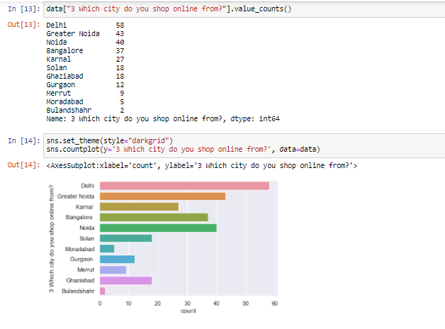
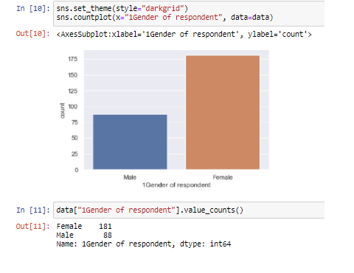
SOME VISULIZATIONS USED FOR EDA.

Slide 8
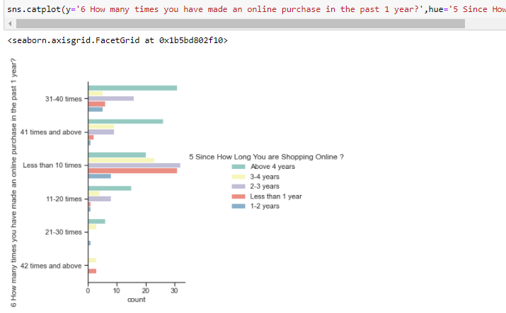
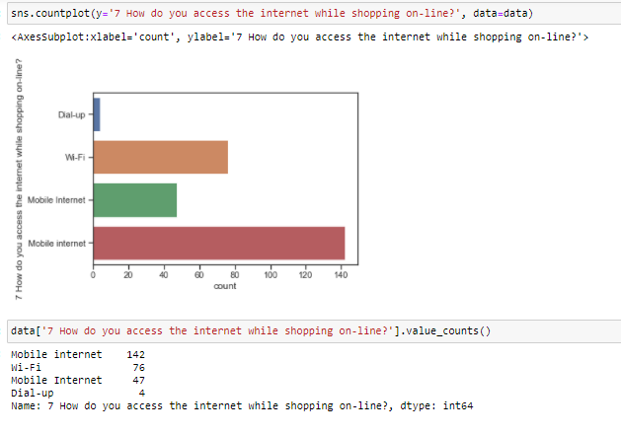
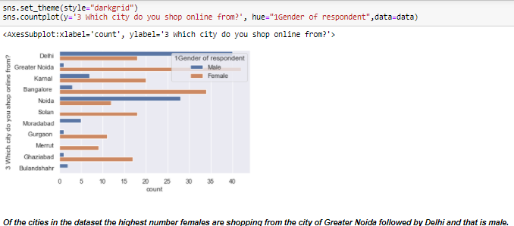
Some more visualizations.

Slide 9
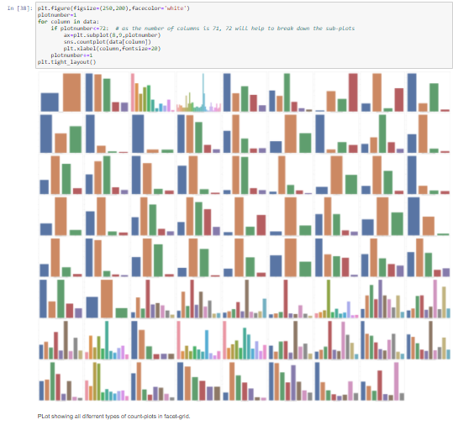

Slide 10
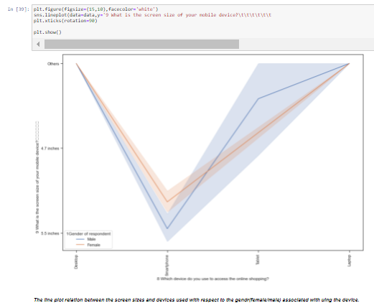
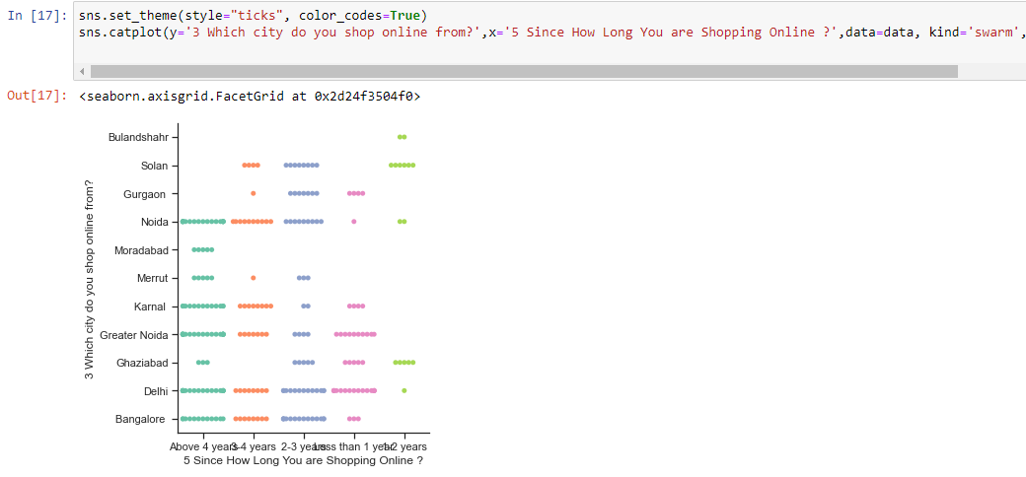

Slide 11
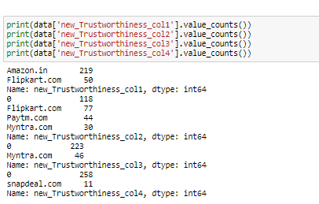
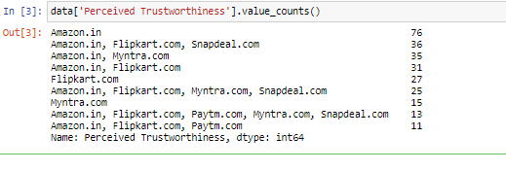
TACKLING THE ISSUES.
THE DATASET HAD COLUMNS WITH MULTIPLE OVERLAPPING VALUES WICH HAD TO BE SLPIT IN THE FOLLOWING WAY.
A column having multiple overlapping values.
The same column after being split into its other counter parts.
It can be seen from the above comparison between the same columns that after splitting the column better understanding of the column can be achieved.

Slide 12
Findings on the dataset.
The dataset showed based on online shopping experience Delhi and Greater Noida had the most number of people shopping for more than 4 years with Greater Noida having the mot number of female shoppers and Delhi having the most number of male shoppers less than Greater Noida.
The dataset also revealed gender wise female shoppers are more than in comparison to male shoppers.
The dataset was able to show why Amazon was the favorite of the users as it was most recommended online retailer among users.
As for various cases like "trustworthiness" , "website efficiency", " Reliability", "variety_of_product_offer", etc it was seen that the customers preferred Amazon.in(as 219 people preferred shopping from it) more in comparison to the other online retailers. After Aamazon.in, Flipkart .com was the second most preferred website as voted for by 127 people.
Of the feedbacks from 269 people 219 like shopping from Amazon.in and 127 people like hopping from Flipkart.com , 76 people liked shopping from Myntra.com , 44 people from Paytm.com and only 11 from Snapdeal.com.
It can be understood that people like to switch in between websites and shop specially in between Amazon.in and Flipkart.com.

Slide 13
DRAWING A CONCLUSION.
The dataset contains a detailed information about the e-commerce industry of India with the passage of time multiple Online-retailers have come to create a highly efficient market place where product can be bought an sold from the safe confines of ones' home. The dataset helps provide light on some of the important factors that help define the company to the customers which in turn helps to build a bigger better customer base which is loyal. The dataset dive into a lot of information starting from the Gender of the users to their preferences of using different devices for accessing the internet, the browsers that they use, the screen size of their device , preferences about the website , delivery of products and also the loading speed , how much time it takes to log in ,etc. It actually goes on to show how well the data collection has been done . It also shows how much attention to detail has been given about the customer satisfaction. One thing that is clear from the dataset provided is the fact all the online retailers mentioned namely
- Amazon.in
- Flipkart.com
- Myntra.com
- Paytm.com
- Snapdeal.com
care deeply about providing a better experience to the shoppers and want to make it very much to the liking of its users.
It can be understood that people like to switch in between websites and shop specially in between Amazon.in and Flipkart.com.
What was interesting to observe was that the more a retailer is able provide a better experience to it's shoppers the more shoppers are drawn to it. It could be seen that various people from different geography and age groups were shopping online and mostly the shoppers were female

